Slide 1


vs
Where do you want your money at?
BY Julian Sotelo, Hunter Cruz, Emily Blanchfield, Kendall Johnson, and Isabel Altero

Slide 2
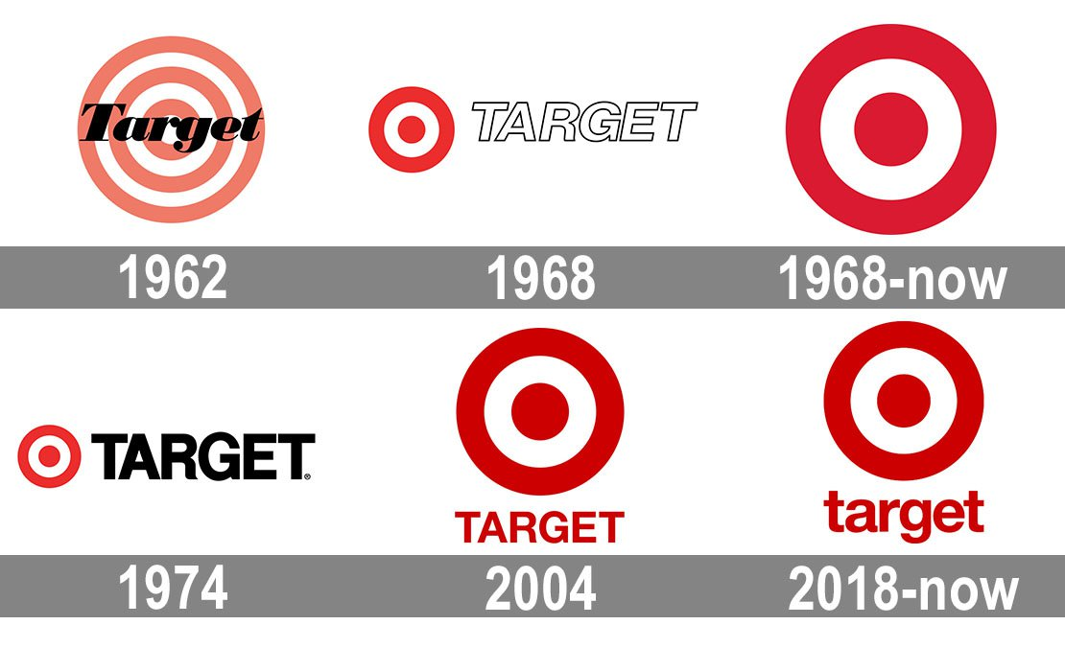
Target's History
As of 2018, Target has had a total revenue growth of millions at 3.6% with total sales of $74,433 million dollars
At 2019s third quarter comparable sales grew 4.5 percent, on top of 5.1 percent last year, meaning that comparable sales have risen nearly 10 percent over the last two years.
Notes:
-As of 2018, Target has had a total revenue growth of millions at 3.6% with total sales of $74,433 million dollars
-At 2019s third quarter comparable sales grew 4.5 percent, on top of 5.1 percent last year, meaning that comparable sales have risen nearly 10 percent over the last two years.

Slide 3
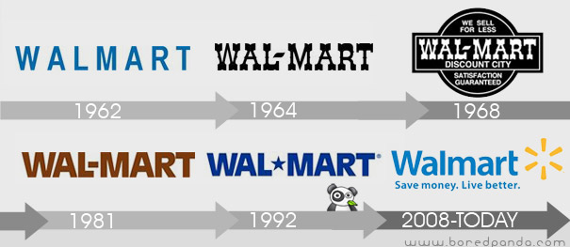
Walmart's History
As of 2018, Walmart delivered the highest comp sales growth in nine years and U.S ecommerce sales grew 44%.
At 2019s third quarter, Total revenue was $128.0 billion, an increase of $3.1 billion, or 2.5%.

Slide 4
Target Income Statement
Breakdown | TTM | 1/31/2019 | 1/31/2018 | 1/31/2017
Total Revenue | $77,690,000 | $75,356,000 | $72,714,000 | $69,495,000
Cost of Revenue | $54,707,000 | $53,299,000 | $51,125,000 | $51,997,000
Gross Profit | $22,983,000 | $22,057,000 | $21,589,000 | $21,788,000
Walmart Income Statement
Breakdown | TTM | 1/31/2019 | 1/31/2018 | 1/31/2017
Total Revenue | $521,086,000 | $514,405,000 | $500,343,000 | $485,873,000
Cost of Revenue | $391,764,000 | $385,301,000 | $373,396,000 | $361,256,000
Gross Profit | $129,322,000 | $129,104,000 | $126,947,000 | $124,617,000
Notes:
INCOME STATEMENT
As you can see above, we are comparing the income statements of both Target and Walmart. The analyzation of the gross profit margin, total revenue, and gross profit the data starting from the base year 2017 to TTM. With this analyzation of each of the income statements, we can better decide which grocer we can put money into and get a return profit from.
-Even though we are given the gross profit for each year and there is improvement along the years, we must see which company is worth the investment. Therefore the gross profit margin (gross profit/total revenue) gives us a better indicator of the profitability of our investment.
Target
Gross Profit Margin (2017-2019)
1/31/2019- 29.27%
1/31/2018- 29.69%
1/31/2017- 31.35%
Trailing Twelve Months(TTM)-29.58%
Walmart
Gross Profit Margin (2017-2019)
1/31/2019-25.09%
1/31/2018-25.37%
1/31/2017-25.64%
Trailing Twelve Months(TTM)- 24.81%
In conclusion- The data shows that the gross profit margin for Target (around 29%) is higher than Walmart’s gross profit margin (around 25%).
*According to Yahoo Finance
Investing into Target would make sense but basing it strictly off the income statement is not advisable.

Slide 5
Walmart (top) and Target (bottom) Net Incomes
Breakdown | 2019 | 2018 | 2017 | 2016 | 2015
Net Income continuing Operation | ($36B) | $29B | $81B | $100B | $68B
Net Income | $6.67B | $9.86B | $13.64B | $14.69B | $16.18B
Net Income Applicable to Common | $6.67B | $9.86B | $13.64B | $14.69B | $16.1B
Breakdown | TTM | 1/31/2019 | 1/31/2018 | 1/31/2017 | 1/31/2016
Net Income Continuing Operation | $3,234,000 | $2,930,000 | $2,908,000 | $2,669,000 | $3,321,000
Net Income | $3,245,000 | $2,937,000 | $2,914,000 | $2,737,000 | $3,363,000
Net Income Applicable to Common | $3,245,000 | $2,937,000 | $2,914,000 | $2,737,000 | $3,363,000
Notes:
The Net Income of a company represents the amount of profit a company has on the year. Knowing the Net Income of a company and past Net Incomes is significant to investors because you don’t want to invest in a company that is losing a ton of Net Income year after year. As seen in the chart, Walmart's Net Income has been decreasing significantly over the last four years. Since 2015 Walmart's Net Income has dropped nearly 60%. To get that percentage I divided the most recent net income by the net income in 2015. As an investor, Walmart would not be a smart choice to invest into currently. On the other hand, Targets net income took a little dip after 2016 but is starting to gain some net income back from 2017 to 2019. Currently, Targets Net Income has dropped 4% since 2016 which is common in this industry. But, Target is on its way up. It has accumulated an 11% gain since the year 2018.
All in all, Walmart may be the big money company but that doesn’t mean it is a smart investment to dump your money into. Through analyzing the data over the past 4 years, Walmart's net income is decreasing dramatically every year. Even though target is not much better, they are slowly but surely on their way back up with Net Income gains in the most recent years.

Slide 6
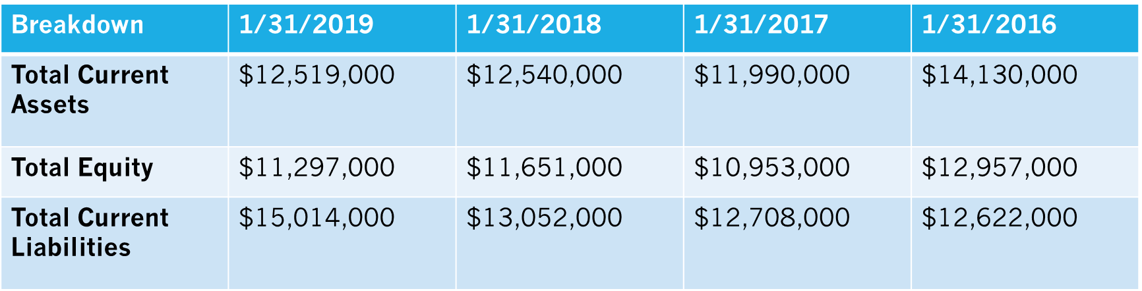
Walmart Balance Sheet
Breakdown | 1/31/2019 | 1/31/2018 | 1/31/2017 | 1/31/2016
Total Current Assets | $61,897,000 | $59,664,000 | $57,689,000 | $60,239,000
Total Equity | $72,496,000 | $77,869,000 | $77,798,000 | $80,546,000
Total Current Liabilities | $77,477,000 | $78,521,000 | $66,928,000 | $64,619,000
Target Balance Sheet
Notes:
Balance Sheet
Above are the balance sheets for each company, included in these are each companies’ total current assets, total equity, and total current liabilities. The balance sheet helps us determine which company to invest in because it determines each companies' current debt ratio and stockholders’ equity ratio. This is important because current ratio helps us determine whether a company can payoff their debt. A current ratio above 1.0 shows that it can pay off short-term debt but if it is anything less then they will not be able to cover the debt they owe. The formula is as follows:
Current Ratio=Current Assets/ Current Liabilities
Stockholders’ equity ratio is also important because it shows an investor how much money they will have if the company were to liquify their assets. Therefore the higher the percentage then the more attractive the stock looks to investors. If the company were to file for bankruptcy, a high stockholders’ equity ratio means that the company has the power to pay its stockholders back. The formula is
Stockholders’ equity ratio=Total Stockholders equity/ Total Assets
The base year being 2016, Walmart’s current ratio is .93 then in 2017 it was .86 and in 2018 it was .76 lastly in 2019 it was .80. This is not good for Walmart because they cannot pay off their debts, and since 2016 there has been a decrease in the company’s current ratio. As for Target, the current ratio for the base year 2016 is 1.11 for 2017 it was .94 then for 2018 it was .96 lastly for 2019 it was .83. Target’s current ratio is in a decline and as an investor this is not a good sign. Neither Target or Walmart show promising current ratios, but Target most recent ratio of .83 is higher than Walmart’s .80.
As for stockholders’ equity ratio, Walmart starts 2016 with 40% then in 2017 it was 39% and in 2018 it was 38% and in 2019 it was 33%. This is not a good sign because there is a decline in the equity ratio which means it is riskier. For Target in 2016 it started at 32% then in 2017 it was 29% after in 2018 it reached 29% and recently in 2019 it reached 27%. These numbers are mediocre at best, this shows that both companies are potentially bad investments. Between the two Target is the better investment due to its current ratio. Even though its equity ratio is about 10% lower, Target is in a better position to pay off its debt and is less risk for bankruptcy.

Slide 7
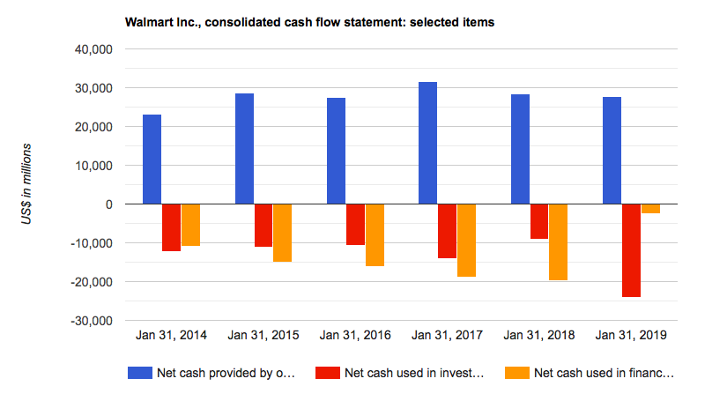
Walmart Statement of Cash Flows
Walmart Inc.’s net cash provided by operating activities decreased from 2017 to 2018 and from 2018 to 2019. It's investing activities increased from 2017 to 2018 but then decreased significantly from 2018 to 2019 and lastly financing activities decreased from 2017 to 2018 but then increased from 2018 to 2019 exceeding 2017 level.
Notes:
Walmart Inc.’s net cash provided by operating activities decreased from 2017 to 2018 and from 2018 to 2019. It's investing activities increased from 2017 to 2018 but then decreased significantly from 2018 to 2019 and lastly financing activities decreased from 2017 to 2018 but then increased from 2018 to 2019 exceeding 2017 level.

Slide 8
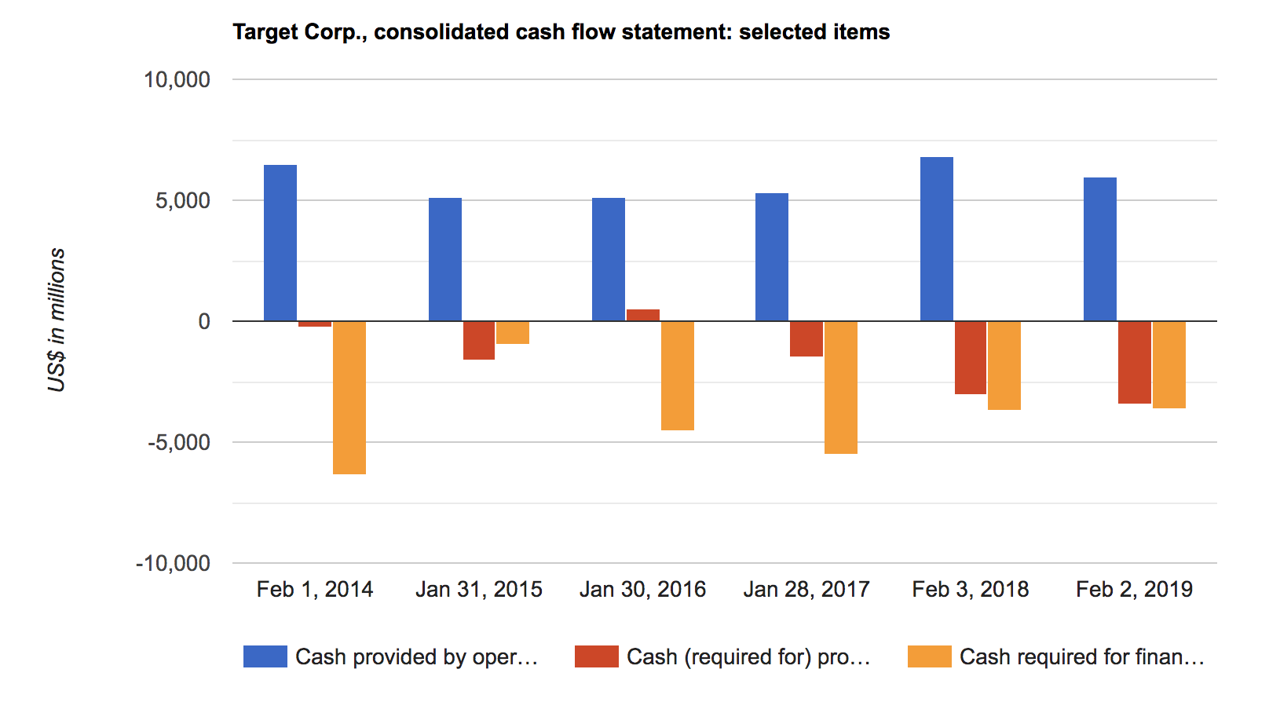
Target Statement of Cash Flows
Target's Inc.'s net cash provided by operating activities increased from 2017-2018 and then decreased from 2018-2019. It's investing activities increased from 2017-2018 and from 2018-2019. Finally the financing activities decreased from 2017-2018 and then again from 2018-2019.
Notes:
Target's Inc.'s net cash provided by operating activities increased from 2017-2018 and then decreased from 2018-2019. It's investing activities increased from 2017-2018 and from 2018-2019. Finally the financing activities decreased from 2017-2018 and then again from 2018-2019.

Slide 9
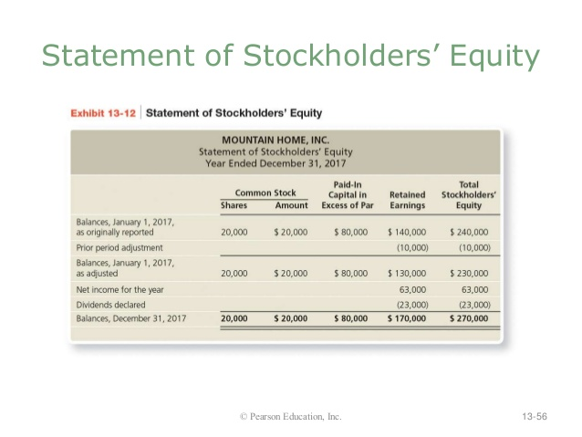
Target & Walmart's Stockholders Equity Standing
Target Corp.’s shareholders’ investment increased from 2017 to 2018 but then slightly decreased from 2018 to 2019 not reaching 2017 level.
Walmart Inc.’s total Walmart shareholders’ equity increased from 2017 to 2018 but then decreased significantly from 2018 to 2019.
A statement of stockholders' equity shows the beginning balance, any additions or subtractions, and the ending balance for all equity accounts. Above are the overall descriptions for both corporations.
Notes:
-Target Corp.’s shareholders’ investment increased from 2017 to 2018 but then slightly decreased from 2018 to 2019 not reaching 2017 level.
-Walmart Inc.’s total Walmart shareholders’ equity increased from 2017 to 2018 but then decreased significantly from 2018 to 2019.
-A statement of stockholders' equity shows the beginning balance, any additions or subtractions, and the ending balance for all equity accounts. Above are the overall descriptions for both corporations.

Slide 10


Conclusion
In conclusion, with all the information taken into consideration, we have come to see that Walmart is the better option compared to Target for an investor.

Slide 11
References
https://ycharts.com/companies/WMT/gross_profit_margin
https://www.marketwatch.com/investing/stock/wmt/financials
https://www.stock-analysis-on.net/NYSE/Company/Target-Corp/Financial-Statement/Statement-of-Cash-Flows
https://finance.yahoo.com/quote/TGT/balance-sheet/
https://finance.yahoo.com/quote/WMT/financials?p=WMT

